Slide 1
NLP

Slide 2
Introduction to NLP
NLP Tasks

Slide 3
Part of Speech Tagging
The swimmer is getting ready to run in the final race.
Notes:
JM slide?

Slide 4
Part of Speech Tagging
The swimmer is getting ready to run in the final race.
Run – verb or noun?
Final – noun or adjective?
Race – verb or noun?
Notes:
JM slide?

Slide 5
Part of Speech Tagging
The candidate is preparing for his run for the presidency.
The swimmer is getting ready to run in the final race.
Notes:
JM slide?

Slide 6
Parsing
Myriam slept.
Myriam wrote a novel.
Myriam gave Sally flowers.
Myriam ate pizza with olives.
Myriam ate pizza with Sally.
Myriam ate pizza with a fork.
Myriam ate pizza with remorse.

Slide 7
Phrase-Structure Grammar
S → NP VP NP → DET N NP → NP PP VP → VBD VP → VBD NP VP → VBD NP NP VP → VP PP PP → PRP NP
DET → the DET → that DET → a N → child N → window N → car VBD → found VBD → ate VBD → saw PRP → in PRP → of PRP → through
Notes:
NP: noun phrase
VP: verb phrase
PP: propositional phrase
DET: determinant

Slide 8
Parse Trees
S
NP
VP
DET
N
VBD
NP
PP
The
child
saw
DET
N
PRP
NP
the
car
through
DET
N
the
window
Notes:
JM?

Slide 9
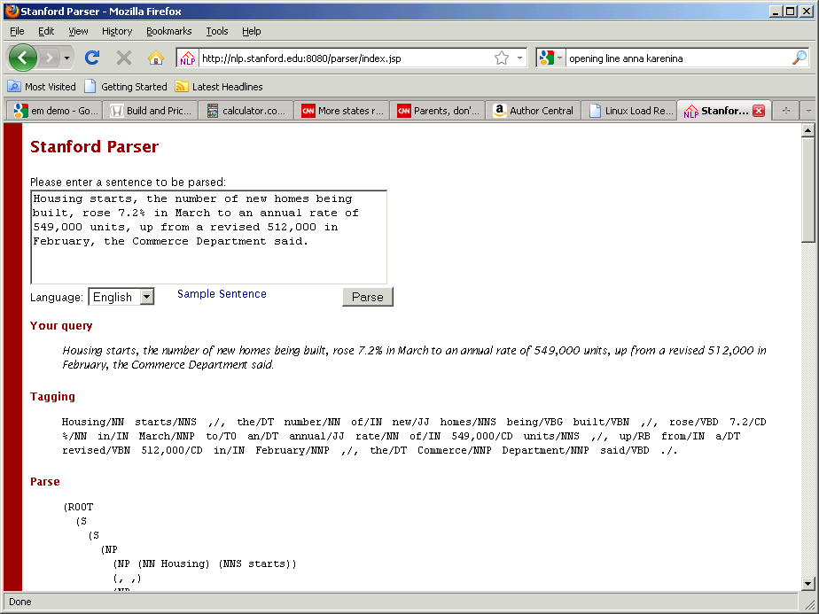
Stanford Parser

Slide 10
Parser Output
(VP (VBD rose)
(NP (CD 7.2) (NN %))
(PP (IN in)
(NP (NNP March)))
(PP (TO to)
(NP
(NP (DT an) (JJ annual) (NN rate))
(PP (IN of)
(NP (CD 549,000) (NNS units)))))
(, ,)
(ADVP (RB up)
(PP (IN from)
(NP
(NP (DT a) (VBN revised) (CD 512,000))
(PP (IN in)
(NP (NNP February))))))))
(, ,)
(NP (DT the) (NNP Commerce) (NNP Department))
(VP (VBD said))
(. .)))
(ROOT
(S
(S
(NP
(NP (NN Housing) (NNS starts))
(, ,)
(NP
(NP (DT the) (NN number))
(PP (IN of)
(NP
(NP (JJ new) (NNS homes))
(VP (VBG being)
(VP (VBN built))))))
(, ,))

Slide 11
This Problem is Pretty // Easy
Commercial for a phone company
Garden path sentences
Don’t bother coming
Don’t bother coming early
Take the turkey out of the oven at five
Take the turkey out of the over at five to four
I got canned
I got canned peaches for dinner
All Americans need to buy a house
All Americans need to buy a house is a lot of money
Can you think of more such examples?

Slide 12
Solution
This problem is pretty // easy
http://www.nacloweb.org/resources/problems/2007/N2007-HS.pdf
Criteria
The part before // should be a complete sentence
The full sentence has a different meaning than the part before //
The part before // should not already be ambiguous

Slide 13
Dependency Parsing
likes
Mary
apples
yellow
Notes:
Find the semantic purpose of a sentence.
Mary modifies likes, apples also modify likes, yellow only modified apples.

Slide 14
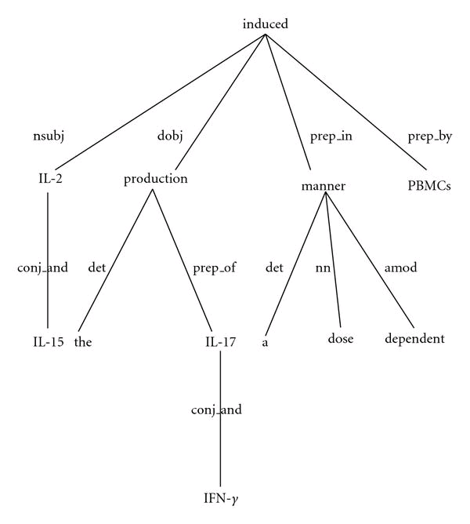
Dependency Parsing
IL-2 and IL-15 induced the production of IL-17 and IFN-γ by PBMCs in a dose dependent manner.

Slide 15
Parser Output
nn(starts-2, Housing-1)
nsubj(rose-12, starts-2)
det(number-5, the-4)
appos(starts-2, number-5)
prep(number-5, of-6)
amod(homes-8, new-7)
pobj(of-6, homes-8)
auxpass(built-10, being-9)
partmod(homes-8, built-10)
ccomp(said-36, rose-12)
num(%-14, 7.2-13)
dobj(rose-12, %-14)
prep(rose-12, in-15)
pobj(in-15, March-16)
prep(rose-12, to-17)
det(rate-20, an-18)
amod(rate-20, annual-19)
pobj(to-17, rate-20)
prep(rate-20, of-21)
num(units-23, 549,000-22)
pobj(of-21, units-23)
advmod(rose-12, up-25)
dep(up-25, from-26)
det(512,000-29, a-27)
amod(512,000-29, revised-28)
pobj(from-26, 512,000-29)
prep(512,000-29, in-30)
pobj(in-30, February-31)
det(Department-35, the-33)
nn(Department-35, Commerce-34)
nsubj(said-36, Department-35)

Slide 16
Information Extraction
RESEARCH ALERT-Wells Fargo cuts PPD Inc to market perform
China Southern Air Upgraded To Overweight From Neutral-HSBC
CITIGROUP RAISES INGERSOLL RAND <IR.N> TO HOLD FROM SELL
TCF Financial Corp Raised To Overweight From Neutral By JPMorgan
BAIRD CUTS KIOR INC <KIOR.O> TO UNDERPERFORM RATING
BRIEF-RESEARCH ALERT-Global Equities Research cuts LinkedIn to equal weight
Notes:
Words with the same color have the same semantics.

Slide 17
Information Extraction
DATE/TIME | TICKER | COMPANY | SOURCE | OLD | NEW | CHANGE
 |  | PPD Inc | Wells Fargo |  | market perform
 |  | China Southern Air | HSBC | Neutral | Overweight
 | IR.N | INGERSOLL RAND | CITIGROUP | SELL | HOLD
 |  | TCF Financial Corp | JPMorgan | Neutral | Overweight
 | KIOR.O | KIOR INC | BAIRD |  | UNDERPERFORM
 |  | LinkedIn | Global Equities Research |  | equal weight

Slide 18
False Positives
Examples of false positives
BARCLAYS CUTS FLAGSTONE REINSURANCE <FSR.N> PRICE TARGET TO $9 FROM $11
Rimage To Buy Qumu For $52M;; Raises Dividend;; Lowers EPS View
S&P rates Ameren Illinois commercial paper 'A-3'
BRIEF-Moody's changes otlk for Stirling Water Seafield Finance to positive
BRIEF-RESEARCH ALERT-HSBC cuts price targets on European telcos
Stifel cuts Philip Morris price target
Media General shares plummet on Moody's downgrade
Explain why these are false positives.

Slide 19
Answers to the Quiz
BARCLAYS CUTS FLAGSTONE REINSURANCE <FSR.N> PRICE TARGET TO $9 FROM $11
Didn’t cut the ratings but the price target
Rimage To Buy Qumu For $52M;; Raises Dividend;; Lowers EPS View
Lowers eps view
S&P rates Ameren Illinois commercial paper 'A-3‘
Debt rating
BRIEF-Moody's changes otlk for Stirling Water Seafield Finance to positive
Changes outlook
BRIEF-RESEARCH ALERT-HSBC cuts price targets on European telcos
Not a company but a group of companies
Stifel cuts Philip Morris price target
Price target, not rating
Media General shares plummet on Moody's downgrade
Event in the past

Slide 20
Semantics
First order logic
Inference/deduction
Semantic analysis
∀x,y: Mother (x,y) ⇒ Parent (x,y)
Notes:
First order logic: representation about facts (knowledge about the world).

Slide 21
NACLO Problem
“Bertrand and Russell”, 2014 problem by Ben King
http://www.nacloweb.org/resources//problems/2014/N2014-H.pdf
to be covered in a later lecture

Slide 22
NACLO Solution
Bertrand and Russell
http://www.nacloweb.org/resources/problems/2014/N2014-HS.pdf

Slide 23
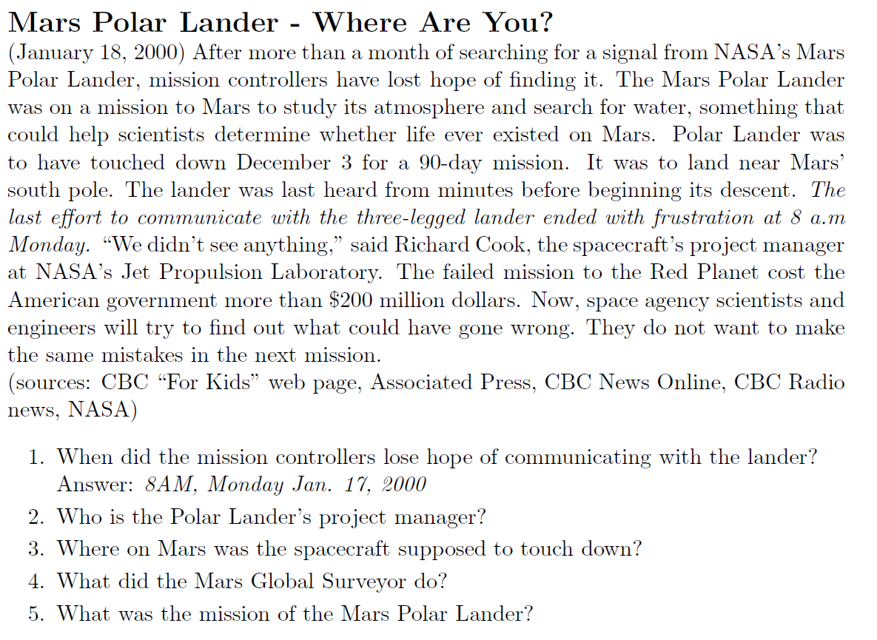
Reading Comprehension
Pranav Anand, Eric Breck, Brianne Brown, Marc Light, Gideon Mann, Ellen Riloff, Mats Rooth, Michael Thelen. 2000.
Fun with Reading Comprehension

Slide 24
Text Understanding
There are four bungalows in our cul-de-sac. They are made from these materials: straw, wood, brick and glass. Mrs. Scott's bungalow is somewhere to the left of the wooden one and the third one along is brick. Mrs. Umbrella owns a straw bungalow and Mr. Tinsley does not live at either end, but lives somewhere to the right of the glass bungalow. Mr. Wilshaw lives in the fourth bungalow, whilst the first bungalow is not made from straw. Who lives where, and what is their bungalow made from?
http://www.brainbashers.com/showpuzzles.asp?puzzle=ZSOP

Slide 25
Word Sense Disambiguation
“The thieves took off with 100 gold bars”.
Did they steal 100 drinking establishments?
Or 100 measures of a song?

Slide 26
Word Sense Disambiguation
Bar=Noun
S: (n) barroom, bar, saloon, ginmill, taproom (a room or establishment where alcoholic drinks are served over a counter) "he drowned his sorrows in whiskey at the bar"
S: (n) bar (a counter where you can obtain food or drink) "he bought a hot dog and a coke at the bar"
S: (n) bar (a rigid piece of metal or wood; usually used as a fastening or obstruction or weapon) "there were bars in the windows to prevent escape"
S: (n) measure, bar (musical notation for a repeating pattern of musical beats) "the orchestra omitted the last twelve bars of the song"
S: (n) bar (an obstruction (usually metal) placed at the top of a goal) "it was an excellent kick but the ball hit the bar"
S: (n) prevention, bar (the act of preventing) "there was no bar against leaving"; "money was allocated to study the cause and prevention of influenza"
S: (n) bar ((meteorology) a unit of pressure equal to a million dynes per square centimeter) "unfortunately some writers have used bar for one dyne per square centimeter"
S: (n) bar (a submerged (or partly submerged) ridge in a river or along a shore) "the boat ran aground on a submerged bar in the river"
S: (n) legal profession, bar, legal community (the body of individuals qualified to practice law in a particular jurisdiction) "he was admitted to the bar in New Jersey"
S: (n) stripe, streak, bar (a narrow marking of a different color or texture from the background) "a green toad with small black stripes or bars"; "may the Stars and Stripes forever wave"
S: (n) cake, bar (a block of solid substance (such as soap or wax)) "a bar of chocolate"
S: (n) Browning automatic rifle, BAR (a portable .30 caliber automatic rifle operated by gas pressure and fed by cartridges from a magazine; used by United States troops in World War I and in World War II and in the Korean War)
S: (n) bar (a horizontal rod that serves as a support for gymnasts as they perform exercises)
S: (n) bar (a heating element in an electric fire) "an electric fire with three bars"
S: (n) bar ((law) a railing that encloses the part of the courtroom where the judges and lawyers sit and the case is tried) "spectators were not allowed past the bar"
Bar=Verb
S: (v) bar, debar, exclude (prevent from entering; keep out) "He was barred from membership in the club"
S: (v) barricade, block, blockade, stop, block off, block up, bar (render unsuitable for passage) "block the way"; "barricade the streets"; "stop the busy road"
S: (v) banish, relegate, bar (expel, as if by official decree) "he was banished from his own country"
S: (v) bar (secure with, or as if with, bars) "He barred the door"

Slide 27
WSD is Important for Translation
Paul plays soccer
Paul joue au football
Paul plays the guitar
Paul joue de la guitare
“wall” in German
die Chinesische Mauer (The Great Wall of China)
(otherwise Wand)
“wall” in Spanish
pared, muro, muralla

Slide 28
Named Entity Recognition
Wolff B-PER
, O
currently O
a O
journalist O
in O
Argentina B-LOC
, O
played O
with O
Del B-PER
Bosque I-PER
in O
the O
final O
years O
of O
the O
seventies O
in O
Real B-ORG
Madrid I-ORG
. O
Wolff, currently a journalist in Argentina, played with Del Bosque in the final years of the seventies in Real Madrid.
http://cogcomp.cs.illinois.edu/page/demo_view/NER
http://nlp.stanford.edu:8080/ner/

Slide 29
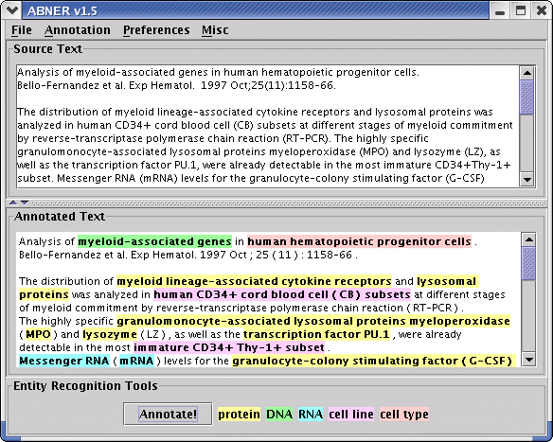
Named Entity Recognition
http://pages.cs.wisc.edu/~bsettles/abner

Slide 30
Semantic Role Labeling
[_{A0} He ] [_{AM-MOD} would ] [_{AM-NEG} n't ] [_{V} accept ] [_{A1} anything of value ] from [_{A2} those he was writing about ] .
V: verb A0: acceptor A1: thing accepted A2: accepted-from A3: attribute AM-MOD: modal AM-NEG: negation
http://cogcomp.cs.illinois.edu/page/demo_view/SRL

Slide 31
Coreference Resolution
Barack Obama visited China. The US president met with his Chinese counterpart.
Cynthia went to see her aunt at the hospital. She was scheduled for surgery on Monday.
Because he was sick, Michael stayed home on Friday.
Notes:
The US president refers to Barack Obama.
She refers to her aunt.

Slide 32
Question Answering
"The antagonist of Stevenson's Treasure Island." (Who is Long John Silver?)
http://blog.reddit.com/2011/02/ibm-watson-research-team-answers-your.html
“Watson is powered by 10 racks of IBM Power 750 servers running Linux, and uses 15 terabytes of RAM, 2,880 processor cores and is capable of operating at 80 teraflops. Watson was written in mostly Java but also significant chunks of code are written C++ and Prolog, all components are deployed and integrated using UIMA.”

Slide 33
Jeopardy Questions
From the competition between the IBM Watson system and two human champions (Ken Jennings and Brad Rutter)
Sample questions:
On December 8, 2008 this national newspaper raised its newsstand price by 25 cents to $1 : USA Today
In 2010 this former first lady published the memoir "Spoken From the Heart" : Laura Bush*
This person is appointed by a testator to carry out the directions & requests in his will : Executor*
Familiarity is said to breed this, from the Latin for "Despise" : Contempt*
As of 2010, Croatia & Macedonia are candidates but this is the only former Yugoslav republic in the EU : Slovenia
The ancient "Lion of Nimrud" went missing from this city's national museum in 2003 (along with a lot of other stuff) : Baghdad
It's just a bloody nose! You don't have this hereditary disorder once endemic to European royalty : Haemophilia
It's Michelangelo's fresco on the wall of the Sistine Chapel, Depicting the saved and the damned : The Last Judgement
She "Died in the church and was buried along with her name. Nobody came" : Eleanor Rigby
It's a 4-letter term for a summit; the first 3 letters mean a type of simian : Apex
A camel is a horse designed by this : Committee
Watson’s answers: 66 correct and 9 incorrect (e.g., the one in the category “US Cities” about a city with two airports named after a World War II hero and a World War II battle)
Watson's two day winning streak was $77,147. Ken Jennings ended with $24,000 and Brad Rutter with $21,600. Watson donated $500,000 to both World Vision and World Community Grid charities from the $1,000,000 prize.
http://www.quora.com/What-questions-were-asked-in-the-Jeopardy-episode-involving-Watson
Notes:
REFORMAT

Slide 34
Sentiment Analysis
“I like the camera because I can edit images so easily, exactly as I do my iPad. I have found that its difficult to frame a picture when there isn't a zoom function as with the iPad. With this camera I can adjust my images by cropping as I did with my iPad but better yet, this camera has a built in zoom. A stretch or pinch of the fingers bring in the subject closer or back out again. With this iPhone I can also, as I dido with my iPad, enhance, crop, rotate, red eye reduce, and set a range of tints. I am also quite impressed with the quality of the images. Pretty darn good especially better than I expected for low light situations where I can use the built-in flash! Quite frankly I was quite surprised with these built in features. I also hope too experiment with and learn what HDR photography is. It's built into this iPhone and can be activated by a the touch of an icon. ”
http://www.epinions.com/review/apple_iphone_5c_latest_model_16gb_graphite_unlocked_smartphone/content_640679317124

Slide 35
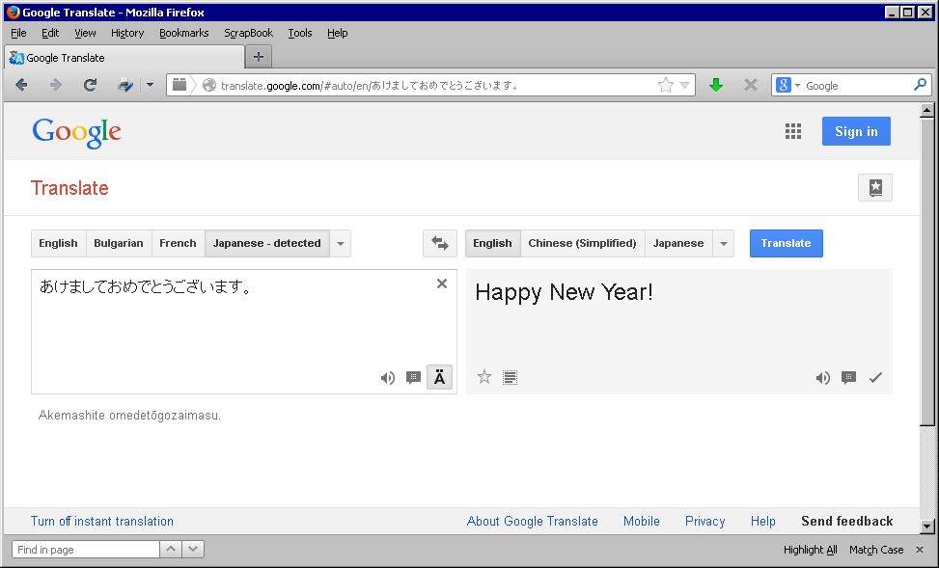
Machine Translation
あけましておめでとうございます。
Happy New Year!

Slide 36
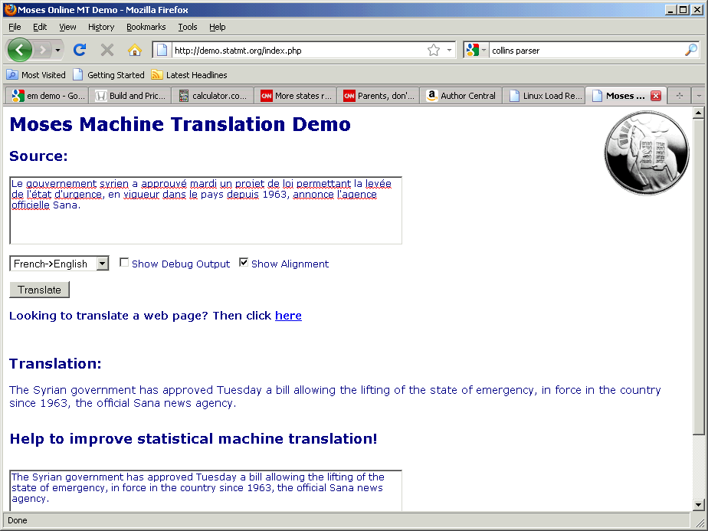
Machine Translation
Moses
www.statmt.org

Slide 37
Elephants are social animals. They live with their families, give hugs and call each other by using their trunks as trumpets. They also might know how to help each other.
In a recent elephant study by researchers from the United States and Thailand, pairs of giant animals learned to work together to get some ears of corn. Other animals, especially some primates, are already known to work together to complete tasks, but now elephants have joined the club. Perhaps the finding is not too surprising: Scientists suspect that elephants, with their big brains and survival savvy, may be among the smartest animals on the planet.
Joshua Plotnik, who worked on the study, told Science News that the animals didn’t just learn a trick. Instead, the ways the elephants behaved show that they understand how working together brings benefits to everyone involved. Plotnik is a comparative psychologist now at the University of Cambridge in England. Psychology is the study of behaviors and mental processes, and comparative psychologists study how animals other than humans behave.
Les éléphants sont des animaux sociaux. Ils vivent avec leur famille, faire des câlins et appeler les uns les autres en utilisant leurs troncs trompettes. Ils pourraient également savoir comment aider les uns les autres. Dans une étude récente d'éléphants par des chercheurs des États-Unis et la Thaïlande, des paires d'animaux géants ont appris à travailler ensemble pour obtenir des épis de maïs. D'autres animaux, en particulier des primates, sont déjà connus pour travailler ensemble pour accomplir des tâches, mais maintenant, les éléphants ont rejoint le club. Peut-être le résultat n'est pas trop surprenant: Les scientifiques soupçonnent que les éléphants, avec leurs gros cerveaux et de bon sens de survie, peut-être parmi les plus intelligents des animaux sur la planète. Joshua Plotnick, qui a travaillé sur l'étude, dit Nouvelles de la Science que les animaux n'ont pas seulement appris un truc. Au lieu de cela, les moyens les éléphants se comportent montrent qu'ils comprennent comment travailler ensemble apporte des avantages à toutes les personnes impliquées. Plotnik est un psychologue comparative maintenant à l'Université de Cambridge en Angleterre. La psychologie est l'étude des comportements et des processus mentaux, et étude comparative des psychologues comment les animaux autres que les humains se comportent.
https://student.societyforscience.org/article/theres-no-i-elephant

Slide 38
Elephants are social animals. They live with their families, give hugs and call each other by using their trunks as trumpets. They also might know how to help each other.
In a recent elephant study by researchers from the United States and Thailand, pairs of giant animals learned to work together to get some ears of corn. Other animals, especially some primates, are already known to work together to complete tasks, but now elephants have joined the club. Perhaps the finding is not too surprising: Scientists suspect that elephants, with their big brains and survival savvy, may be among the smartest animals on the planet.
Joshua Plotnik, who worked on the study, told Science News that the animals didn’t just learn a trick. Instead, the ways the elephants behaved show that they understand how working together brings benefits to everyone involved. Plotnik is a comparative psychologist now at the University of Cambridge in England. Psychology is the study of behaviors and mental processes, and comparative psychologists study how animals other than humans behave.
Les éléphants sont des animaux sociaux. Ils vivent avec leur famille, faire des câlins et appeler les uns les autres en utilisant leurs troncs trompettes. Ils pourraient également savoir comment aider les uns les autres. Dans une étude récente d'éléphants par des chercheurs des États-Unis et la Thaïlande, des paires d'animaux géants ont appris à travailler ensemble pour obtenir des épis de maïs. D'autres animaux, en particulier des primates, sont déjà connus pour travailler ensemble pour accomplir des tâches, mais maintenant, les éléphants ont rejoint le club. Peut-être le résultat n'est pas trop surprenant: Les scientifiques soupçonnent que les éléphants, avec leurs gros cerveaux et de bon sens de survie, peut-être parmi les plus intelligents des animaux sur la planète. Joshua Plotnick, qui a travaillé sur l'étude, dit Nouvelles de la Science que les animaux n'ont pas seulement appris un truc. Au lieu de cela, les moyens les éléphants se comportent montrent qu'ils comprennent comment travailler ensemble apporte des avantages à toutes les personnes impliquées. Plotnik est un psychologue comparative maintenant à l'Université de Cambridge en Angleterre. La psychologie est l'étude des comportements et des processus mentaux, et étude comparative des psychologues comment les animaux autres que les humains se comportent.
https://student.societyforscience.org/article/theres-no-i-elephant

Slide 39
Machine Translation
Noisy channel model (“Chinese Whispers”)
f
e
E → F
F → E
e’
encoder
decoder
e’ = argmax P(e|f) = argmax P(f|e) P(e)
e
e
translation model
language model

Slide 40
Machine Translation
IBM Method
IS THIS YOUR FAVORITE PLAY ?
IS THIS YOUR FAVORITE PLAY PLAY PLAY ?
** ** ** THIS IS YOUR PLAY PLAY PLAY FAVORITE ?
EST-CE QUE C’ EST VOTRE PIECE DE THEATRE PREFEREE ?
Language model
Translation model

Slide 41
Single Document Summarization
[Wei and Gao 2014]

Slide 42
Multi Document Summarization
Health Benefits
Eating a diet rich in vegetables and fruits as part of an overall healthy diet may reduce risk for heart disease, including heart attack and stroke.
Eating a diet rich in some vegetables and fruits as part of an overall healthy diet may protect against certain types of cancers.
Diets rich in foods containing fiber, such as some vegetables and fruits, may reduce the risk of heart disease, obesity, and type 2 diabetes.
Eating vegetables and fruits rich in potassium as part of an overall healthy diet may lower blood pressure, and may also reduce the risk of developing kidney stones and help to decrease bone loss.
Eating foods such as vegetables that are lower in calories per cup instead of some other higher-calorie food may be useful in helping to lower calorie intake.
Nutrients
Most vegetables are naturally low in fat and calories. None have cholesterol. (Sauces or seasonings may add fat, calories, or cholesterol.)
Vegetables are important sources of many nutrients, including potassium, dietary fiber, folate (folic acid), vitamin A, and vitamin C.
Diets rich in potassium may help to maintain healthy blood pressure. Vegetable sources of potassium include sweet potatoes, white potatoes, white beans, tomato products (paste, sauce, and juice), beet greens, soybeans, lima beans, spinach, lentils, and kidney beans.
Dietary fiber from vegetables, as part of an overall healthy diet, helps reduce blood cholesterol levels and may lower risk of heart disease. Fiber is important for proper bowel function. It helps reduce constipation and diverticulosis. Fiber-containing foods such as vegetables help provide a feeling of fullness with fewer calories.
Folate (folic acid) helps the body form red blood cells. Women of childbearing age who may become pregnant should consume adequate folate from foods, and in addition 400 mcg of synthetic folic acid from fortified foods or supplements. This reduces the risk of neural tube defects, spina bifida, and anencephaly during fetal development.
Vitamin A keeps eyes and skin healthy and helps to protect against infections.
Vitamin C helps heal cuts and wounds and keeps teeth and gums healthy. Vitamin C aids in iron absorption.

Slide 43
Summary
Eating vegetables is healthy.

Slide 44
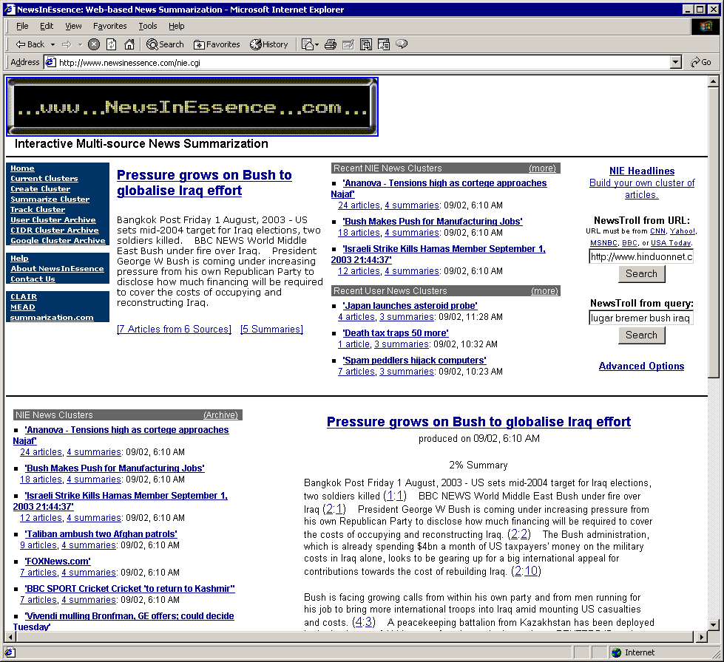

Slide 45
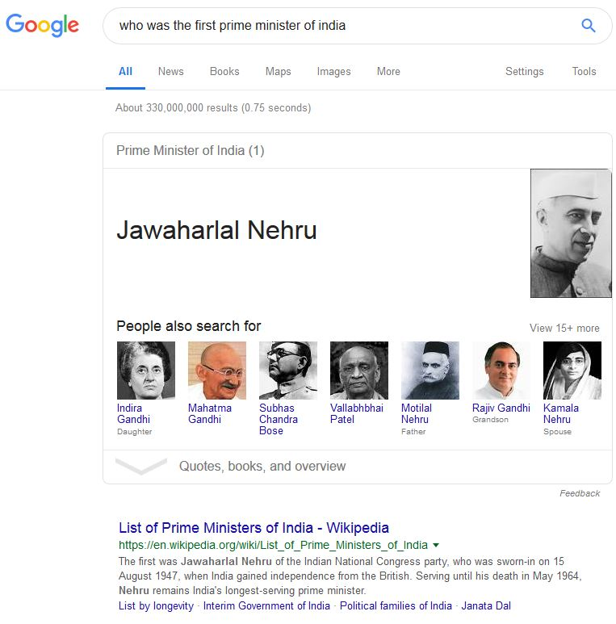
Question Answering

Slide 46
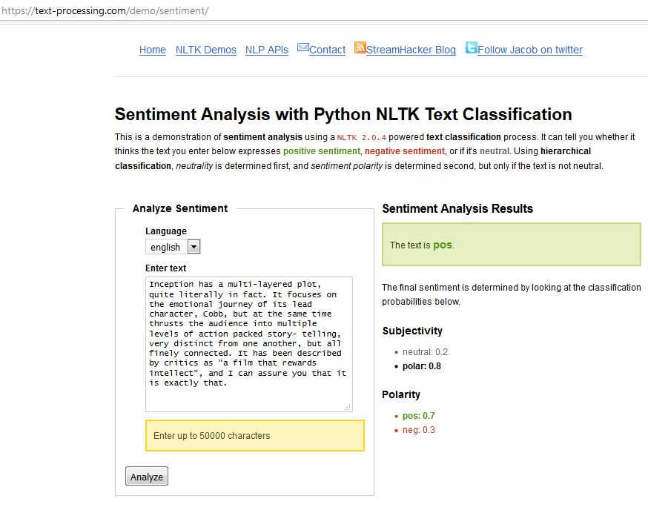
Sentiment Analysis

Slide 47
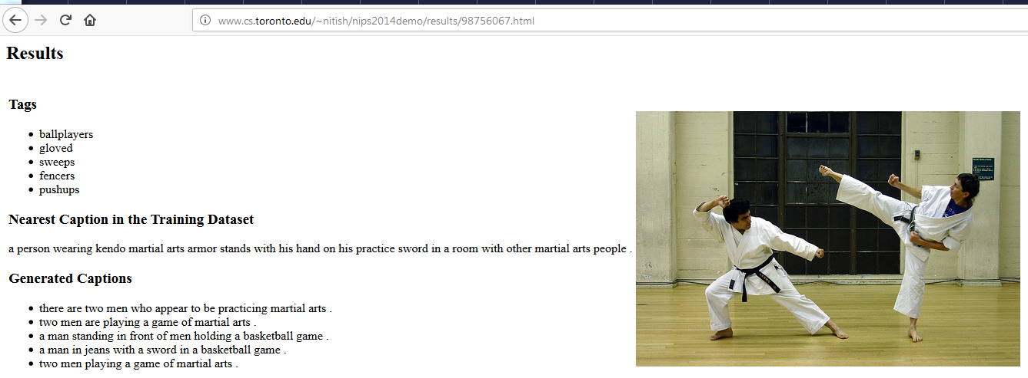
Caption Generation

Slide 48
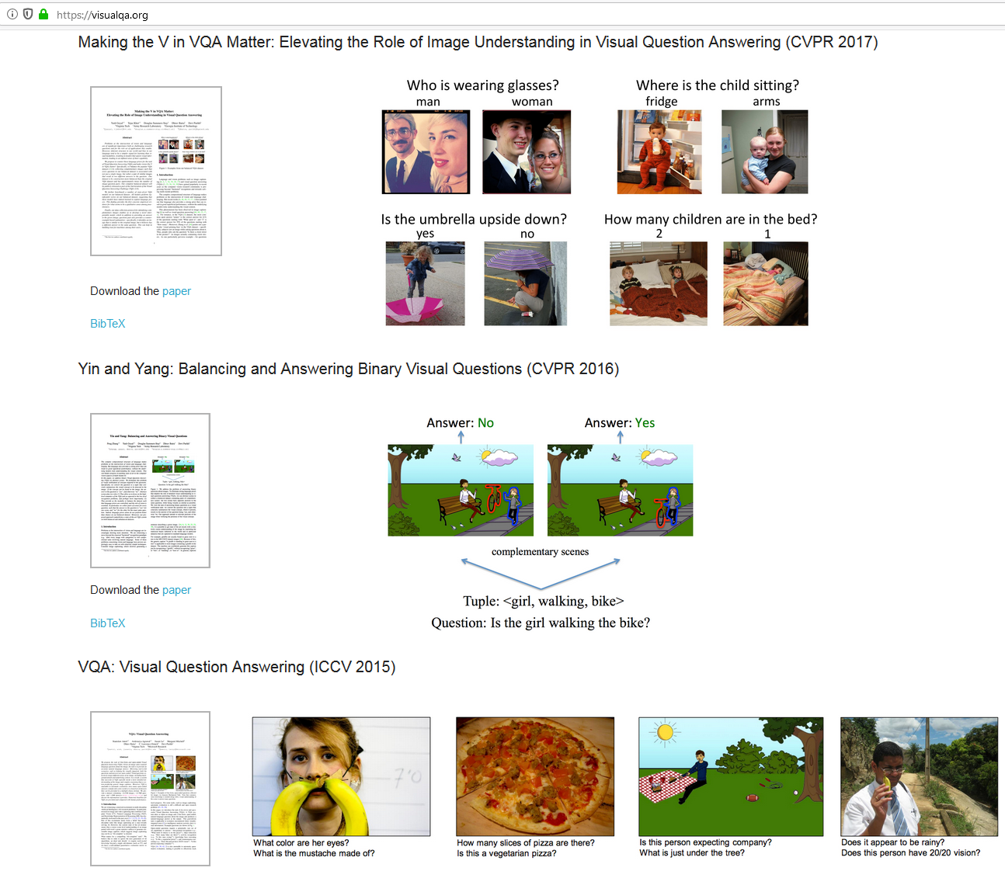
Visual Question Answering

Slide 49
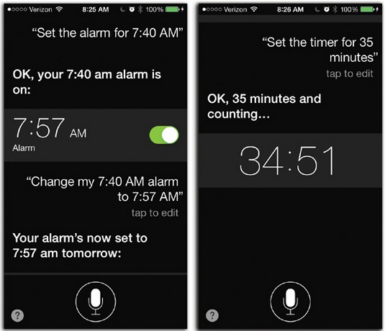
Conversational Agents
https://www.oreilly.com/library/view/iphone-the-missing/9781449372781/ch04.html

Slide 50
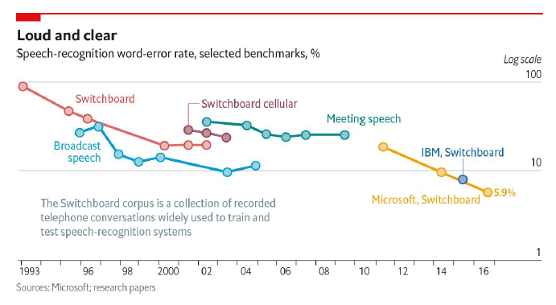
Speech Recognition

Slide 51
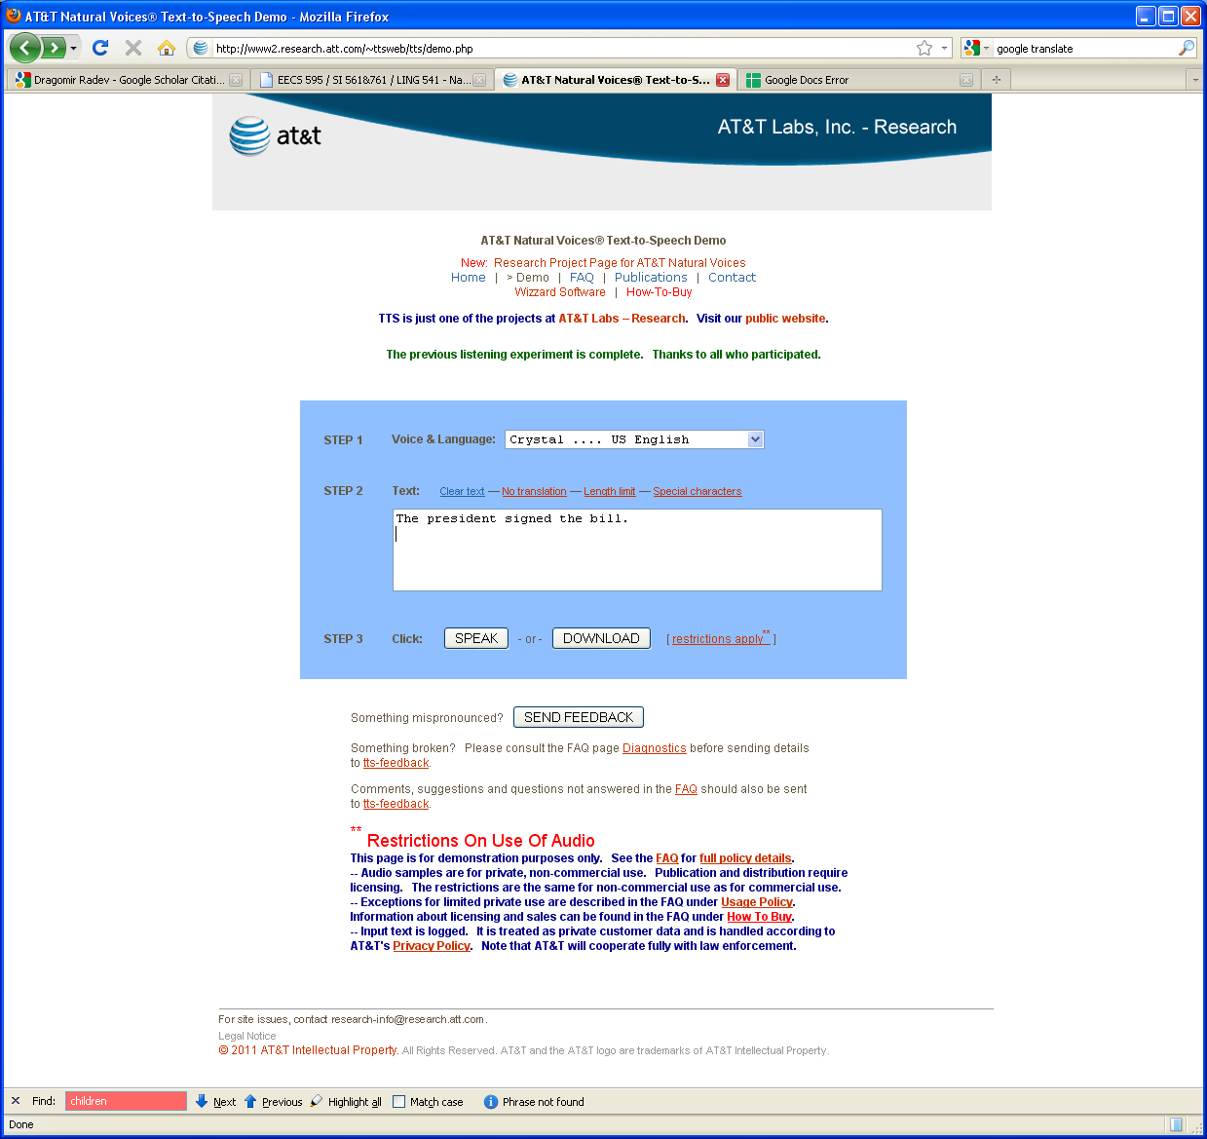
Text to Speech
http://www2.research.att.com/~ttsweb/tts/demo.php

Slide 52
Text to Speech
www.ivona.com

Slide 53
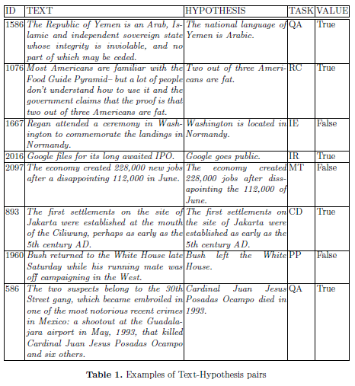
Entailment and Paraphrasing
Ido Dagan, Oren Glickman and Bernardo Magnini. The PASCAL Recognising Textual Entailment Challenge

Slide 54
Discourse Analysis
Anaphoric relations:
1. Mary helped Peter get out of the car. He thanked her. 2. Mary helped the other passenger out of the car. The man had asked her for help because of his foot injury.
Tom appeared on the sidewalk with a bucket of whitewash and a long-handled brush. He surveyed the fence, and all gladness left him and a deep melancholy settled down upon his spirit. (Tom Sawyer)
Notes:
Check provenance

Slide 55
Dialogue Systems
I would like to make a reservation at Sorrento.
For when?
8 pm Friday night.
We only have availability for 7 pm and 10 pm.
Sorry, these don't work for me.
Notes:
CHECK PROVENANCE?

Slide 56
NLP

